Slide 1
Introduction to
Polymorphism
{
< one function,many forms >
}
...

Slide 2
Presented by
}
*

Slide 3
Table of contents
01
02
03
Topic preview
The topic will be described here
Types
The types will be described here
Benefits
Here we will describe the benefits

Slide 4
01
Topic preview
{
..
< let’s discuss the polymorphism >
}
..

Slide 5
What is Polymorphism ?
Poly means many and morphism means shapes
Polymorphism means one function or method can do different things depending on the object it is used with.
It helps in using the same name for different tasks, making the code simpler and more flexible.
}
..

Slide 6
02
Types
{
..
< let’s discuss the types >
}
..

Slide 7
Here are two types
Static polymorphism
Dynamic polymorphism

Slide 8
Static polymorphism !
*
Static polymorphism is compile time polymorphism, Happens when the program is compiled and it is achieved through method overloading
Static polymorphism means defining multiple functions with the same name but with different parameters (type or number). The compiler decides which function to call based on the arguments passed — this decision happens at compile time.

Slide 9
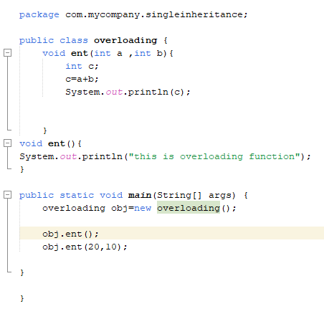
Static polymorphism
{
}
...

Slide 10
Dynamic polmorphism
Dynamic polymorphism is called runtime polymorphism, Happens when the program is running and it is achieved through method overriding
Dynamic polymorphism in Java happens when a child class writes its own version of a method that already exists in the parent class.
The method in the child class must have the same name, same parameters, and same return type as in the parent class.
*

Slide 11
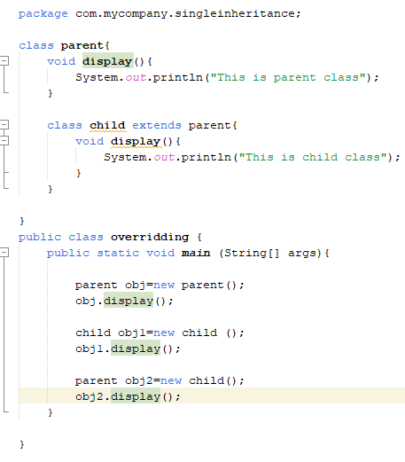
Dynamic polymorphism
{
}

Slide 12
Real Life Example
Consider a smartphone that can perform multiple tasks at the same time. The same device can act as:
A camera when taking pictures,
A music player when playing songs,
A GPS navigator when giving directions.
Although it’s the same device, it behaves differently based on how it is used.

Slide 13
03
Benefits
{
..
< let’s discuss the benefits >
}
..

Slide 14
Benefits
...
Code Reusability
You can use the same function name for different tasks.
No need to write the same code again and again
Improves Performance
Clean and Simple Code
By reducing redundant code and improving the reusability of components, polymorphism can lead to more efficient programs.
Your program looks neat and is easy to understand
Makes it easier for others to read your code

Slide 15
Conclusion
Polymorphism means one function or object can do different things in different situations. It helps us write less code, makes our programs flexible, and easy to change or update. This is very useful when making big or growing projects.
}
..

Slide 16
Thank you
{
..
}
..

